Slide 1

Immigration and Population Replacement Rates
The Handmaid’s Tale Effect

Slide 2

The Republic of Gilead is a futuristic United States where most women of childbearing age have lost their fertility.
Women who are still fertile – and who can’t manage to escape - are forced to bear children for the powerful and elite.
These women are called Handmaids.
Could this happen for real in the United States?

Slide 3
key terms
Population projection components:
Live births – native and non-native (immigrant) women
Deaths
Net International Migration (NIM)
Total Fertility Rate (TFR)
Formula: (# live births / # women ages 15 – 44) * 1000
Replacement Rate: TFR = 2.1 (population stays stable)
If TFR < 2.1, lower death rate and/or higher NIM can offset

Slide 4
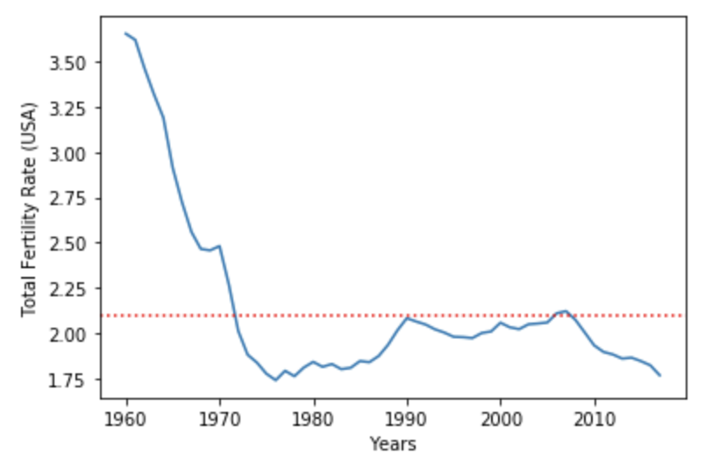
United states TFR trend
The US TFR rate “has generally been below replacement since 1971.” (CDC)
Sources: CDC, World Bank, US Census

Slide 5
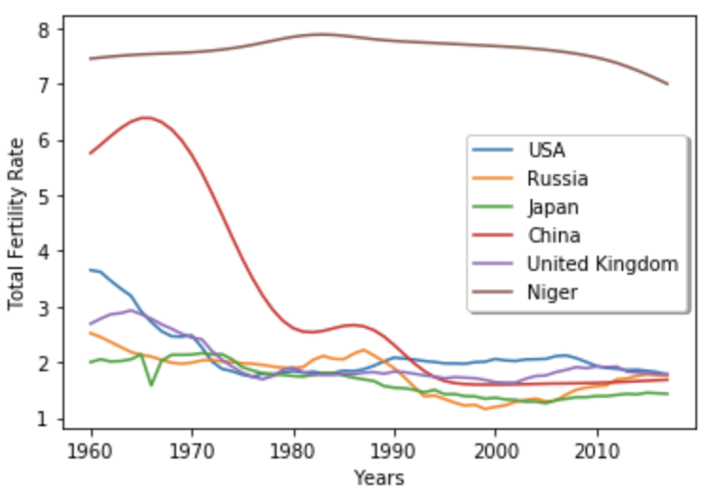
TFR Decline is a global phenomenon
In “developed” countries like the US, TFR tends to be lowest.
Even in “developing” countries like Niger, TFR is slowly declining.
TFR decline is fastest in countries with an aggressive family planning policy like China.
TFR is lowest in countries with a low NIM like Japan.
Source: World Bank

Slide 6
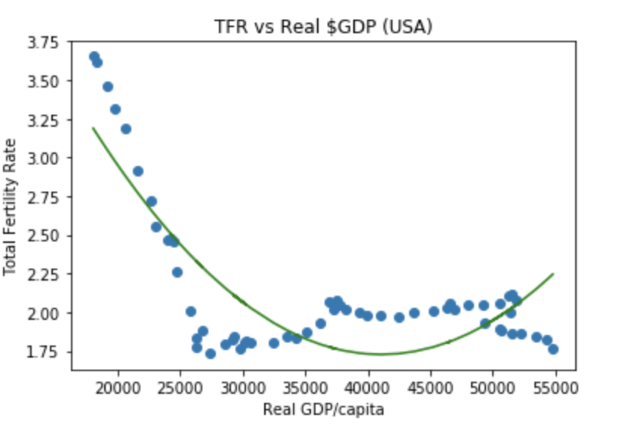
Gdp and tfr are negatively correlated
Source: World Bank

Slide 7
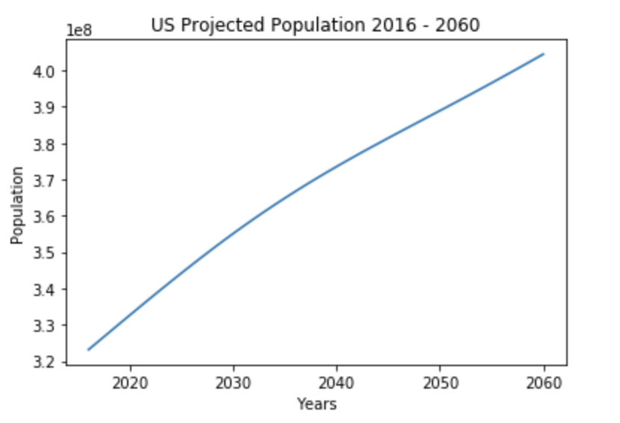
projected total us population
Despite lower TFR, US population is still projected to grow, although the rate slows down around 2035.
Why does it still grow? NIM.
Source: US Census

Slide 8
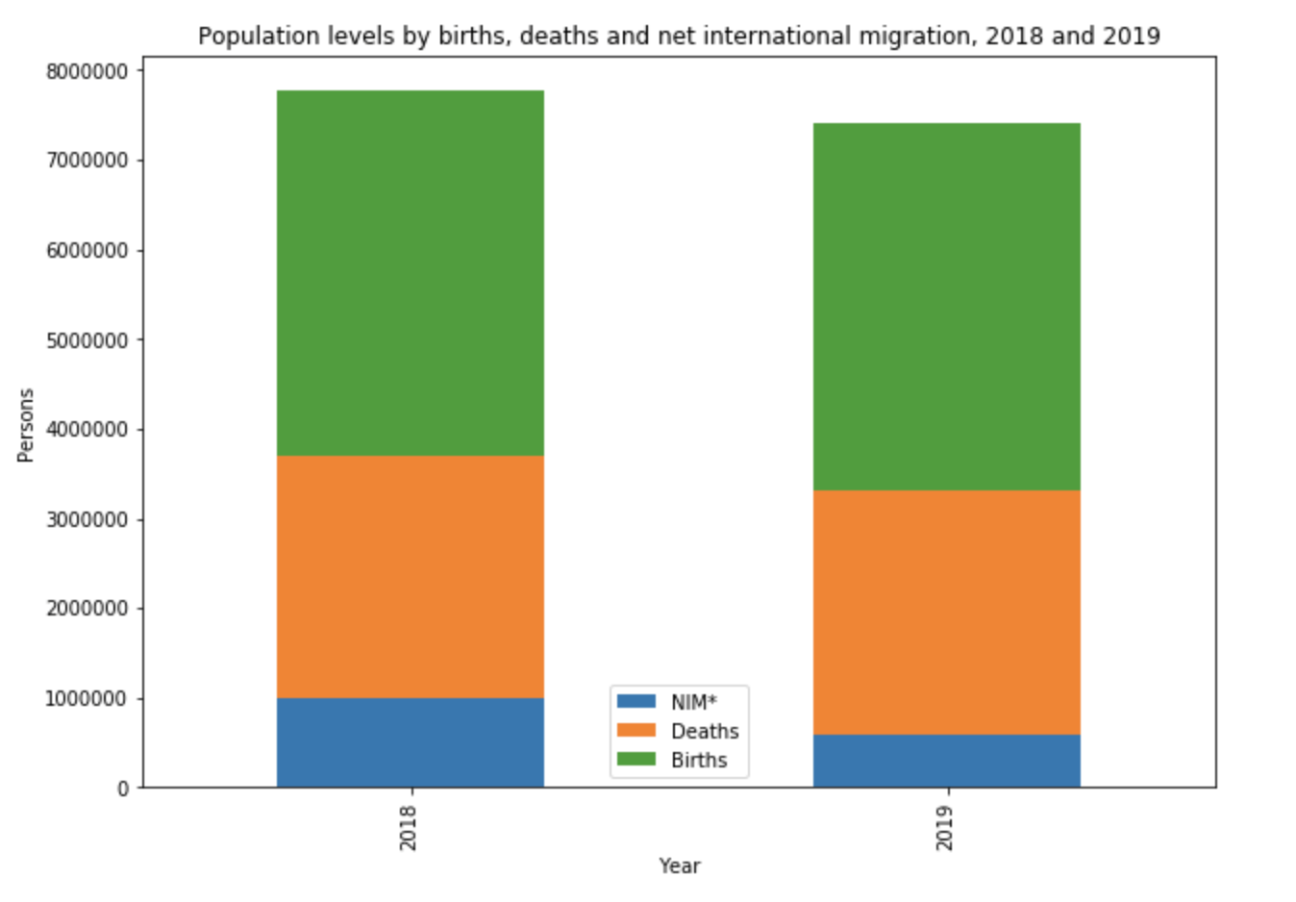
united states NIM
However, the US NIM fell 40.5% in one year (from 1,001,528 in 2018 to 595,348 in 2019) due to Federal policy changes.
The US Census 2016-2060 projection doesn’t account for this.
Source: US Census

Slide 9
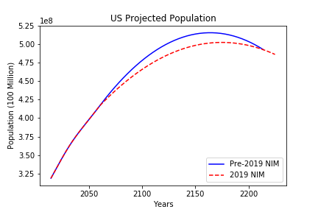
US population trends with Lower nim
With pre-2019 NIM, population would start to decline around 2230.
With 2019 NIM, population would start to decline in 2164.
Key finding: population declines 70 years earlier with lower NIM rate.
Source: US Census

Slide 10
Why is population decline bad?
Disproportionate aging.
Fewer women of child bearing age drastically affects birth rate.
Serious labor shortage – businesses get shuttered, GDP suffers.
Resource shortage.
More spending on elder care.
Shrinking military recruit pool.
Chokehold on infrastructure due to decreased tax base.
Source: World Bank

Slide 11
how do we avoid GILEAD?
Gilead increases birth rate by inhumane policies – we should plan based on projected population trends.
Gilead can’t control NIM because people keep escaping – we should increase NIM.
Source: Hulu

Slide 12
NIM increase can offset population decline
An average NIM of 1,603,698 will sustain the population
Recall: 2019 NIM was 595,348
Source: US Census

